Slide 1

A Federated Learning Aided System for Classifying Cervical Cancer Cells
CSE 400 : Thesis
Group A_10 members:
Ramiza Rumaisa Aliya - 201914015
Nazia Shehnaz Joynab - 201914032
A.S.M. Rakibul Hasan - 201914056
Supervisor : Lt Col Muhammad Nazrul Islam, PhD, Sigs
Co-Supervisor : Lec Nafiz Imtiaz Khan

Slide 2

Outline of the presentation
Introduction
Literature Review
Problem Statements
Thesis Objectives
Methodology
Development of ML models
Development of CNN-based FL Architecture
Result Analysis
Video Demonstration of Our System
Conclusion
Q & A

Slide 3
Introduction
Cervical Cancer is the fourth most common reason for disease demise amongst women worldwide.
More than 50 million Bangladeshi women are at risk of developing cervical cancer, and 17,686 new cases and 10, 362 deaths occur annually. [1]
Deep learning models for semantic segmentation of images require large amounts of data.
In the medical imaging domain, acquiring sufficient data is a significant challenge.
Sharing medical data to a centralized location faces data privacy and ownership issues.

Slide 4
Introduction (Continued)
For cervical cancer classification, we propose a Federated Learning (FL) aided system.
Federated Learning permits individual hospitals to benefit from the rich datasets of multiple non-affiliated hospitals without centralizing the data in one place.
Federated Learning utilizes numerous collaborators for building a strong deep-learning model using a large dataset.
Federated learning helps in reducing the processing time and
ensures better performance of the proposed model.

Slide 5


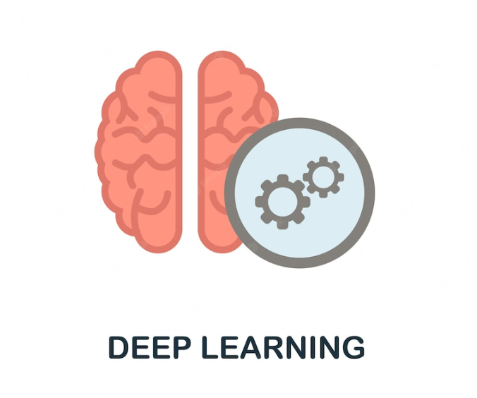

Introduction (Continued)
Deep Learning
Federated Learning
Cervical Cancer
Health Informatics

Slide 6
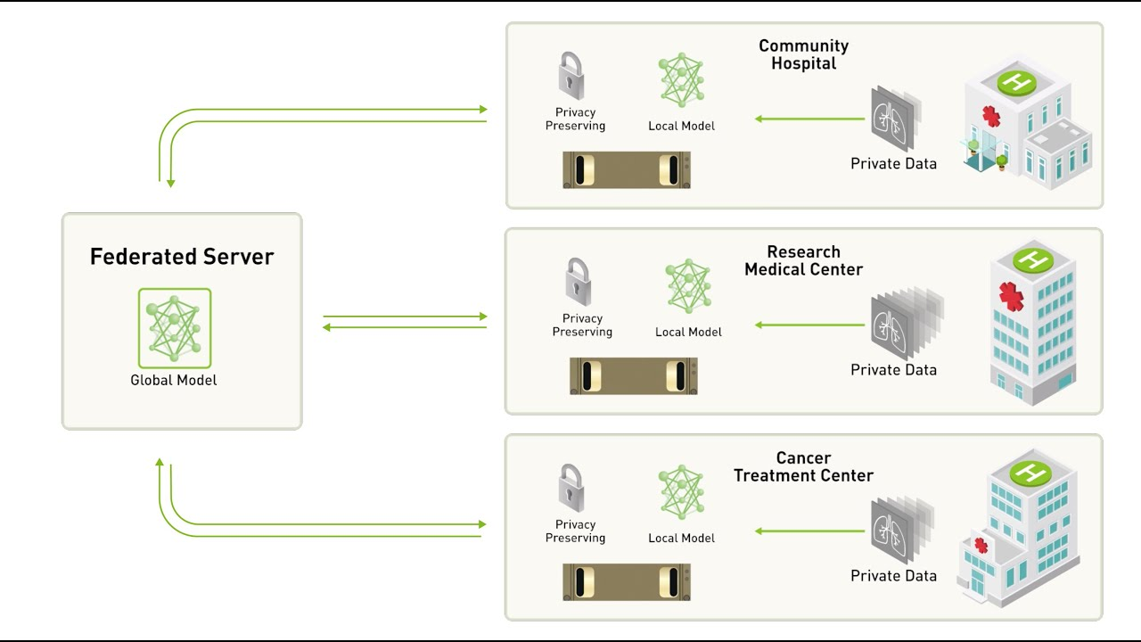
Federated Learning Architecture
Source: [8]

Slide 7
Literature Review
Ref. | Paper Name | Methodology | Result
[2] | Federated Learning aided Breast Cancer Detection with Intelligent Heuristic-based Deep Learning Framework | FL-assisted gathered images were fed to the feature extraction phase using Densenet. Performance enhancement was carried out by tuning certain parameters in E-RNN by HDRO. | The results have demonstrated the effectiveness of the suggested breast cancer diagnosis model
[3] | Multi-Institutional Deep Learning Modeling Without Sharing Patient Data: A Feasibility Study on Brain Tumor Segmentation | Applied FL with CNN architecture, namely U-Net and compared against two alternative collaborating learning techniques: institutional incremental learning (IIL) and cyclic institutional incremental learning (CIIL). | Achieved 99% of the model performance of a data-sharing model with imbalanced datasets, and also achieves superior results compared to the best CIIL models.
[4] | Federated learning for multi-center imaging diagnostics: a simulation study in cardiovascular disease | Presents the federated learning study on cardiovascular magnetic resonance (CMR). Performs a comparative study against Collaborative Data Sharing (CDS). | FL is found to perform better in the experiments than CDS.

Slide 8
Literature Review
Ref. | Paper Name | Methodology | Result
[5] | An Assisted Diagnosis Model for Cancer Patients Based on Federated Learning | Used federated learning, CNN and localized differential privacy. | The accuracy of the prediction of the five types of cancer patient’s is between 65%-85%. This result proves that the model has practical application value.
[6] | Privacy-Preserving Federated Brain Tumour Segmentation | Compare various aspects of FedAVG algorithms and study of the sparse vector technique for a strong differential privacy guarantee. | Achieved comparable segmentation performance without sharing clients’ data. In terms of training time, the data-centralised model took about 300 training epochs, FL training took 600.
[7] | Cervical Cancer Detection and Classification in Cytology Images Using a Hybrid Approach. | A RetinaNet model was used with random forest and SVM classifiers to each of the detected regions for the specification of the final lesion class. | The classification models were able to attain F1 scores of 0.75 and 0.79 for the low and high-grade lesions, respectively, during the 5-fold cross-validation.

Slide 9
Problem Statements
No work done so far on Cervical cancer cell classification using federated learning
Most existing models were trained through data sharing, which hampers data privacy

Slide 10

Objectives
To propose a novel Deep Learning architecture for classification of cervical cancer cells considering small datasets.
To apply Federated Learning architecture in a real-world environment.

Slide 11
Methodology
Developing Classical Machine Learning Models
Data Acquisition
Data Preprocessing
Model Development
Evaluating the Models
10-Fold Cross Validation

Slide 12

Data Acquisition
The dataset was collected from Kaggle namely SipakMed Database.
The dataset contains cluster cell images of Pap smear slides.
The dataset contains a total of 4049 images, each of size 66X66.
The cell images are divided into five categories in which there are
– 813 images of Dyskeratotic cells
– 825 images of Koilocytotic cells
– 793 images of Metaplastic cells
– 787 images of Parabasal cells
– 831 images of Superficial-Intermediate cells.

Slide 13
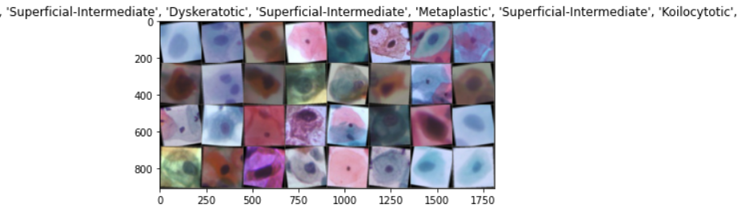
Visualizing the dataset

Slide 14
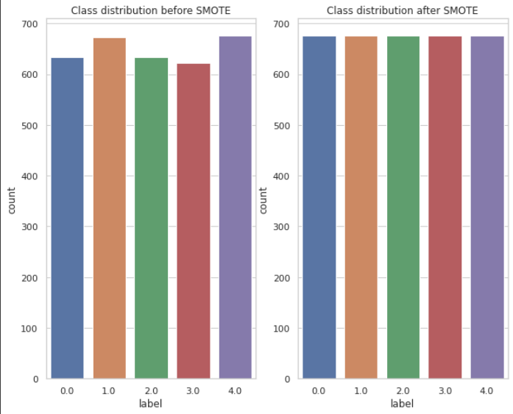
Developing Classical Machine Learning Models
Data Preprocessing
Gray-scale Conversion
Flattening
Resizing the images from 66x66 to 28x28 pixels
Train-Test Splitting (with test ratio=20%)
Handling class imbalance with SMOTE.
Data Normalization
Figure: Class distribution before and after applying SMOTE

Slide 15
Developing Classical Machine Learning Models
Evaluation Metrics:
Model | Train |  |  |  | Test
 | Accuracy (train) | Precision (train) | Recall (train) | F1_score (train) | Accuracy (test) | Precision (test) | Recall (test) | F1_score (test)
LightGBM | 0.999 | 0.999 | 0.999 | 0.999 | 0.72 | 0.714 | 0.718 | 0.714
Histogram Gradient Boosting With LightGBM | 0.999 | 0.999 | 0.999 | 0.999 | 0.72 | 0.714 | 0.718 | 0.714
Histogram Gradient Boosting | 1 | 1 | 1 | 1 | 0.719 | 0.715 | 0.717 | 0.715
Xtra Trees | 1 | 1 | 1 | 1 | 0.701 | 0.694 | 0.701 | 0.694
SVM | 0.694 | 0.69 | 0.694 | 0.689 | 0.698 | 0.689 | 0.695 | 0.688

Slide 16
Developing Classical Machine Learning Models
Evaluation Metrics:
Model | Train |  |  |  | Test
 | Accuracy (train) | Precision (train) | Recall (train) | F1_score (train) | Accuracy (test) | Precision (test) | Recall (test) | F1_score (test)
SVM_Grid_Search | 0.872 | 0.875 | 0.872 | 0.872 | 0.695 | 0.685 | 0.692 | 0.687
Gradient Boosting | 0.846 | 0.847 | 0.846 | 0.845 | 0.686 | 0.678 | 0.685 | 0.678
XGBOOST | 0.77 | 0.775 | 0.77 | 0.768 | 0.683 | 0.678 | 0.681 | 0.674
MLP | 0.705 | 0.716 | 0.705 | 0.704 | 0.673 | 0.681 | 0.67 | 0.668
Histogram Gradient Boosting With XGBoost | 0.768 | 0.771 | 0.768 | 0.766 | 0.669 | 0.662 | 0.667 | 0.66

Slide 17
Developing Classical Machine Learning Models
Evaluation Metrics:
Model | Train |  |  |  | Test
 | Accuracy (train) | Precision (train) | Recall (train) | F1_score (train) | Accuracy (test) | Precision (test) | Recall (test) | F1_score (test)
KNN | 1 | 1 | 1 | 1 | 0.562 | 0.567 | 0.555 | 0.539
Decision Tree | 1 | 1 | 1 | 1 | 0.535 | 0.527 | 0.531 | 0.529
AdaBoost | 0.481 | 0.496 | 0.481 | 0.483 | 0.485 | 0.503 | 0.482 | 0.486
Random Forest | 0.477 | 0.488 | 0.477 | 0.449 | 0.456 | 0.46 | 0.448 | 0.424
Gaussian Naive Bayes | 0.408 | 0.449 | 0.408 | 0.361 | 0.435 | 0.456 | 0.423 | 0.369

Slide 18
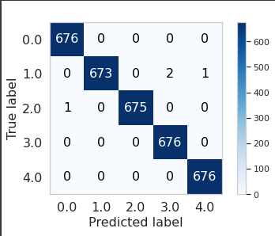
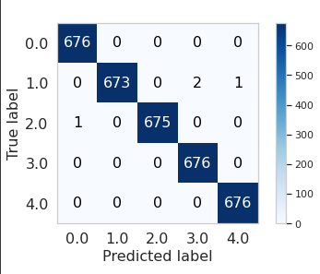
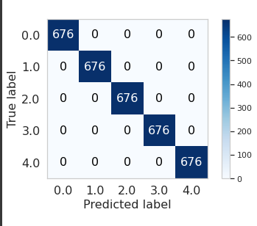
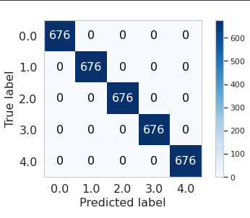
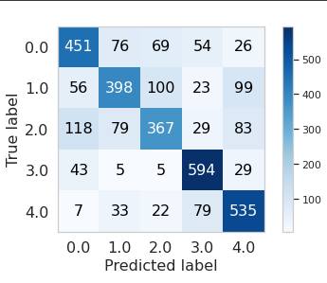
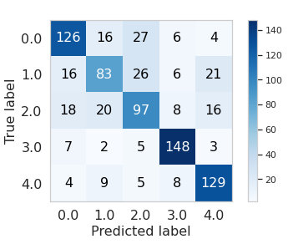
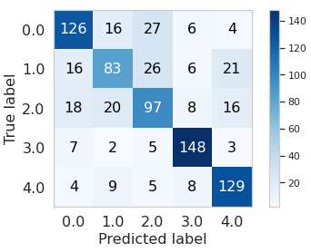
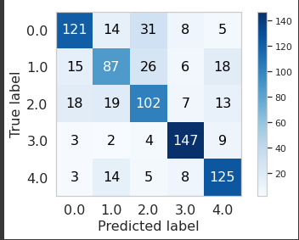
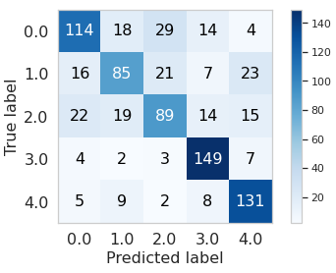
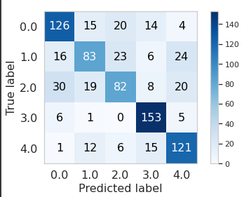
Developing Classical Machine Learning Models
Analysis of Confusion Matrices:
Model | LightGBM | HGB+LightGBM | HGB | Extratrees | SVM
Confusion Matrix of true train vs predicted train
Confusion Matrix of true test vs predicted test

Slide 19
Developing Classical Machine Learning Models
Analysis of Confusion Matrices:

Slide 20
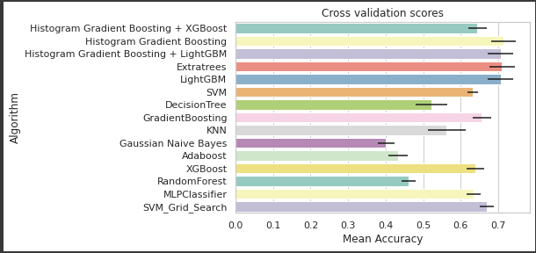
Developing Classical Machine Learning Models
10 Fold Cross Validation Results:

Slide 21
Methodology
Development of CNN-based FL Architecture
Data Acquisition
Train Data Partitioning for Clients
Foundation Model (CNN) Development
Deploy the FL-based CNN model with streamlit
Integrating the best CNN model with FL
Continuous Evaluation of the Models through
Hyperparameter Tuning

Slide 22
Development of CNN-based FL Architecture
Data Partitioning
(for the purpose of testing our FL architecture)
Cervical Cancer largest dataset (SipakMed)
Train (85%)
Client_1(28%)
Client_2(28%)
Client_3(28%)
Test (15%)
Class 1
230 | 230 | 230 | 123
230 | 230 | 228 | 137
215 | 215 | 215 | 148
215 | 215 | 215 | 142
230 | 235 | 231 | 135
Class 2
Class 3
Class 4
Class 5

Slide 23
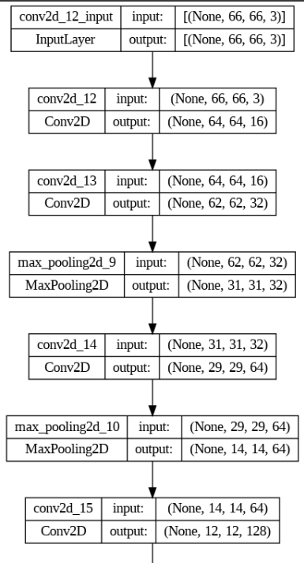
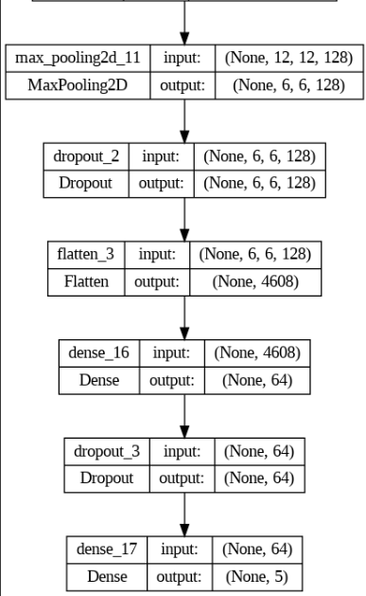
Development of CNN-based FL Architecture
CNN architecture 1
Image Description:
Image Size: 66x66
Color Channel: 3 (RGB)
Classes: 5

Slide 24
Development of CNN-based FL Architecture
Evaluation Metrics (CNN Architecture 1):
Class Name | Precision | Recall | F1-score | ROC_AUC Score (ovr) | Support
Dyskeratotic | 0.91 | 0.69 | 0.79 | 0.84 | 123
Koilocytotic | 0.76 | 0.75 | 0.76 | 0.85 | 137
Metaplastic | 0.86 | 0.89 | 0.88 | 0.93 | 148
Parabasal | 0.93 | 0.81 | 0.87 | 0.89 | 142
Superficial-Intermediate | 0.71 | 0.95 | 0.81 | 0.92 | 135

Slide 25
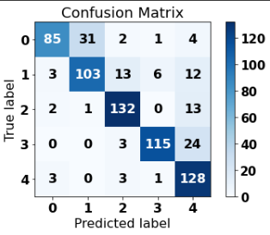
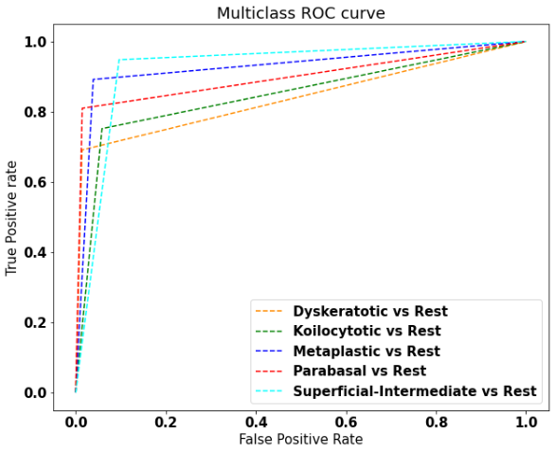
Development of CNN-based FL Architecture
Evaluation Metrics for Test data(CNN Architecture 1):

Slide 26
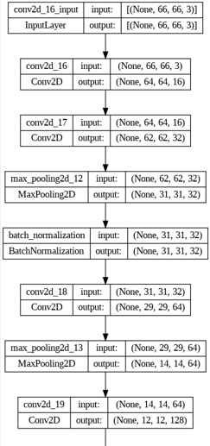
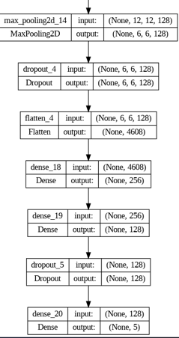
Development of CNN-based FL Architecture
CNN architecture 2
Image Description:
Image Size: 66x66
Color Channel: 3 (RGB)
Classes: 5

Slide 27
Development of CNN-based FL Architecture
Evaluation Metrics (CNN Architecture 2):
Class Name | Precision | Recall | F1-score | roc_auc_score(ovr) | Support
Dyskeratotic | 0.95 | 0.86 | 0.91 | 0.92 | 123
Koilocytotic | 0.78 | 0.56 | 0.65 | 0.76 | 137
Metaplastic | 0.94 | 0.98 | 0.96 | 0.98 | 148
Parabasal | 0.98 | 1.00 | 0.99 | 0.99 | 142
Superficial-Intermediate | 0.72 | 0.93 | 0.81 | 0.92 | 135

Slide 28
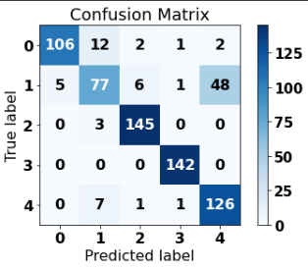
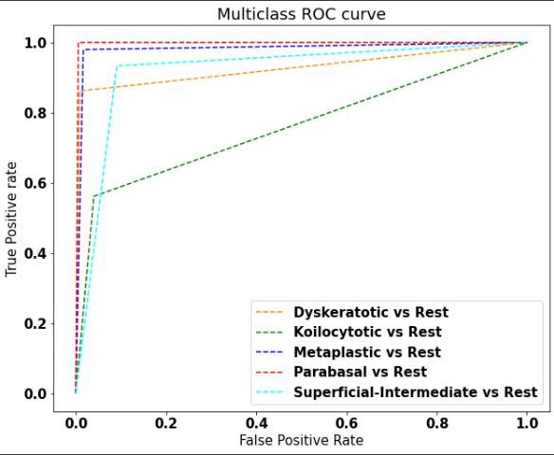
Development of CNN-based FL Architecture
Evaluation Metrics Test data(CNN Architecture 2):

Slide 29
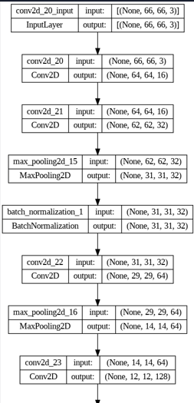
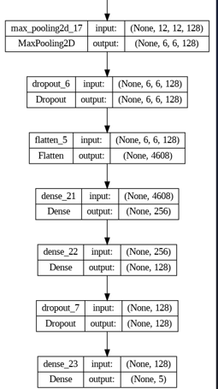
Development of CNN-based FL Architecture
CNN architecture 3
Image Description:
Image Size: 66x66
Color Channel: 3 (RGB)
Classes: 5

Slide 30
Development of CNN-based FL Architecture
Evaluation Metrics (CNN Architecture 3):
Class Name | Precision | Recall | F1-score | ROC_AUC Score (ovr) | Support
Dyskeratotic | 0.98 | 0.87 | 0.92 | 0.93 | 123
Koilocytotic | 0.89 | 0.56 | 0.69 | 0.77 | 137
Metaplastic | 0.91 | 0.99 | 0.95 | 0.98 | 148
Parabasal | 0.97 | 1.00 | 0.98 | 0.99 | 142
Superficial-Intermediate | 0.74 | 0.99 | 0.85 | 0.95 | 135

Slide 31
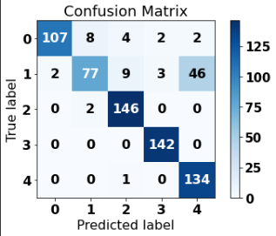
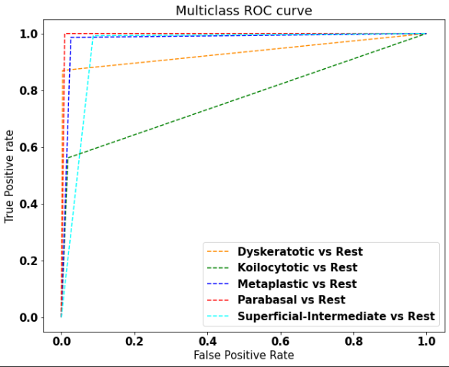
Development of CNN-based FL Architecture
Evaluation Metrics for Test data (CNN Architecture 3):

Slide 32
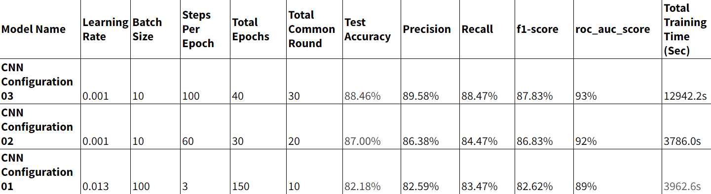
Result Analysis
Evaluation Metrics Comparison of applied CNN configurations:

Slide 33






Tools and Platform Used

Slide 34
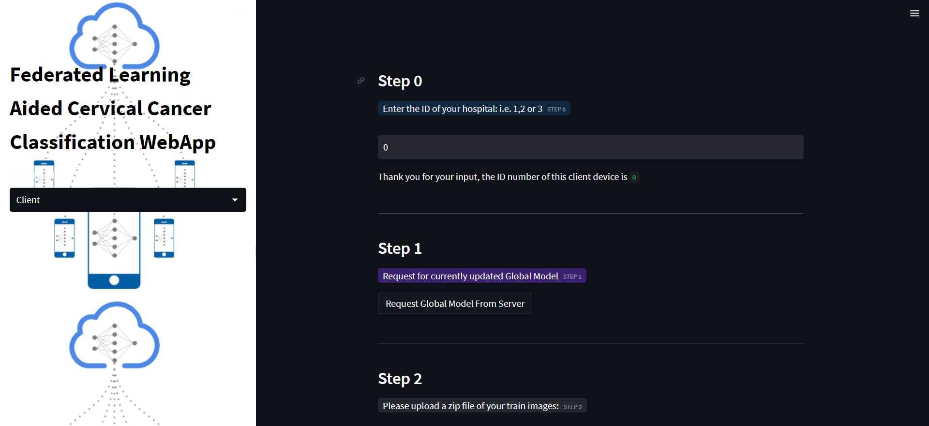
Development of CNN-based FL Architecture
Client Side Frontend

Slide 35
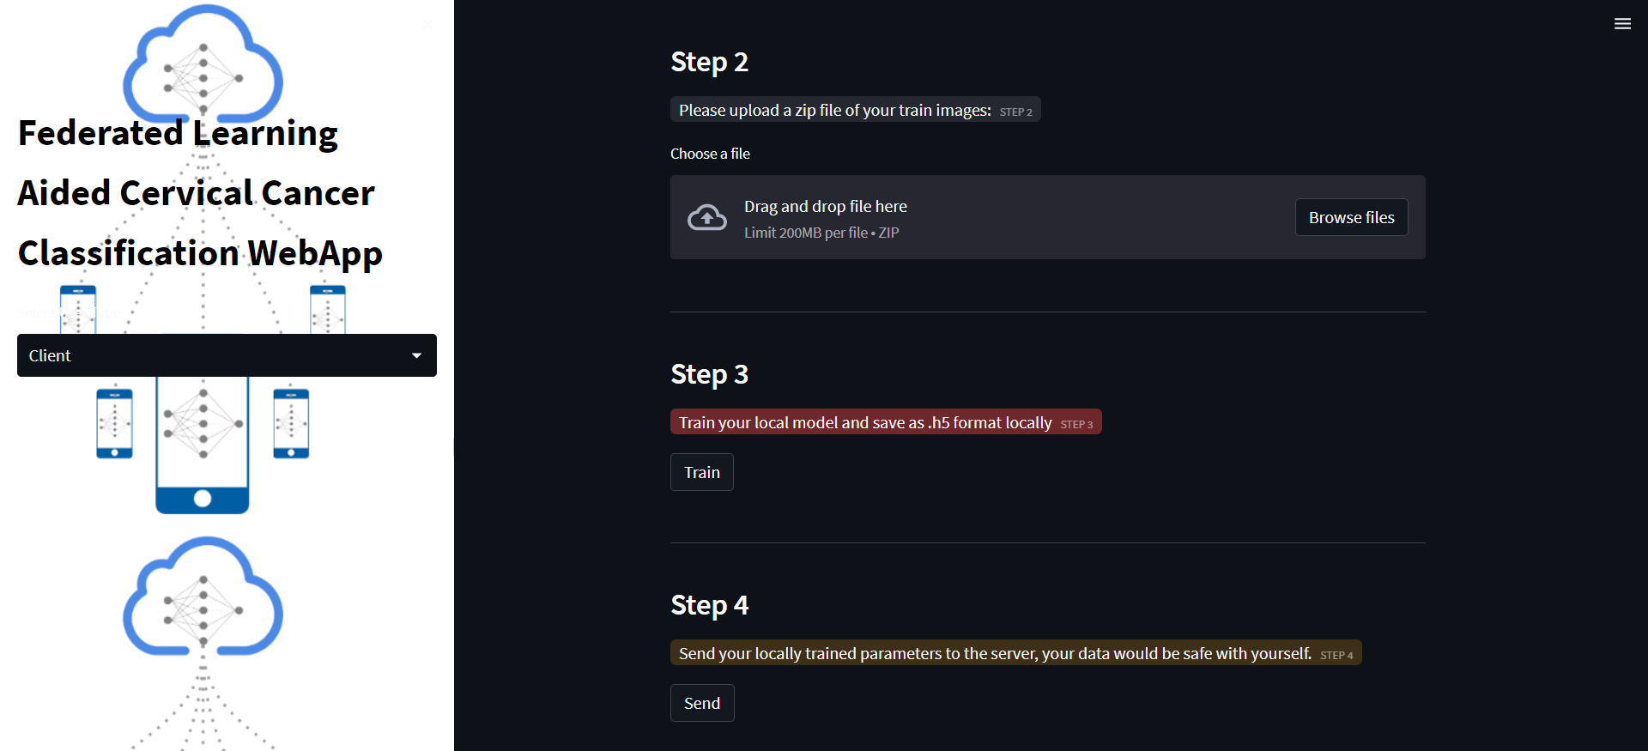
Development of CNN-based FL Architecture
Client Side Frontend

Slide 36
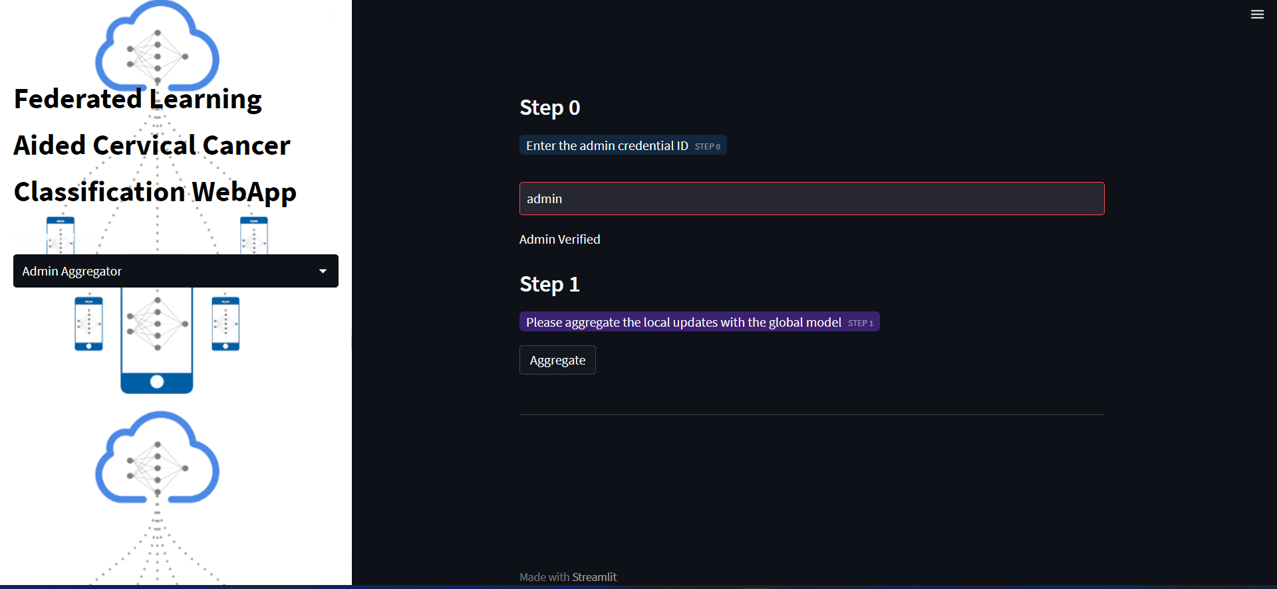
Development of CNN-based FL Architecture
Admin Side (Aggregator) Frontend

Slide 37

Video Demonstration

Slide 38
Conclusion
Federated learning enriches our model by bringing in a diverse set of images of cervical cancer cells from around the world.
As a result, rural hospitals which do not have a sufficient amount of data can use this strategy and have great benefits.
Applying federated Learning on Cervical Cancer may bring a revolutionary change in cervical cancer research

Slide 39
Limitations
Developing Deep Learning models need high computational capacity, which is time consuming.
The proposed system is built as a prototype to incorporate data only from three hospitals. It is possible to make the system scalable for more hospitals.
Acquiring sufficient quantity of data for training purposes poses a significant limitation, though it is crucial for accurate results.

Slide 40
Future Work
Add differential privacy/homomorphic encryption/cryptographic techniques i.e. blockchain for secure aggregation
Add authentication and authorization functionalities for aggregator and clients from frontend

Slide 41
References:
[1] Hoque, M. R., Haque, E., & Karim, M. R. (2020, October 17). Cervical cancer in low‐income countries: A Bangladeshi perspective. International Journal of Gynecology & Obstetrics, 152(1), 19–25. https://doi.org/10.1002/ijgo.13400
[2] atul b kathole. Federated Learning aided Breast Cancer Detection with Intelligent Heuristic-based Deep Learning Framework, 16 June 2022, PREPRINT (Version 1) available at Research Square [https://doi.org/10.21203/rs.3.rs-1764898/v1]
[3] Sheller, M. J., Reina, G. A., Edwards, B., Martin, J., & Bakas, S. (2018, October 22). Multi-institutional deep learning modeling without sharing patient data: A feasibility study on brain tumor segmentation. arXiv.org. Retrieved September 20, 2022, from https://arxiv.org/abs/1810.04304
[4] Linardos, A., Kushibar, K., Walsh, S. et al. Federated learning for multi-center imaging diagnostics: a simulation study in cardiovascular disease. Sci Rep 12, 3551 (2022). https://doi.org/10.1038/s41598-022-07186-4
[5] Ma Z, Zhang M, Liu J, Yang A, Li H, Wang J, Hua D, Li M. An Assisted Diagnosis Model for Cancer Patients Based on Federated Learning. Front Oncol. 2022 Mar 3;12:860532. doi: 10.3389/fonc.2022.860532. PMID: 35311106; PMCID: PMC8928102.
[6] Li, Wenqi & Milletari, Fausto & Xu, Daguang & Rieke, Nicola & Hancox, Jonny & Zhu, Wentao & Baust, Maximilian & Cheng, Yan & Ourselin, Sébastien & Cardoso, Manuel Jorge & Feng, Andrew. (2019). Privacy-Preserving Federated Brain Tumour Segmentation. 10.1007/978-3-030-32692-0_16.
[7] Silva, Eduardo L., et al. “Cervical Cancer Detection and Classification in Cytology Images Using a Hybrid Approach.” Advances in Visual Computing, edited by George Bebis et al., Springer International Publishing, 2021, pp. 299–312. Springer Link, https://doi.org/10.1007/978-3-030-90436-4_24.
[8] Rieke, N. (2019, October 13). What Is Federated Learning? | NVIDIA Blog. NVIDIA Blog. https://blogs.nvidia.com/blog/2019/10/13/what-is-federated-learning/

Slide 42
Thank You

